Slide 1
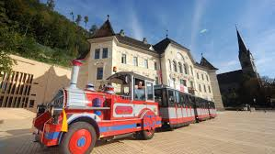
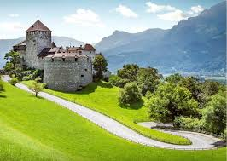
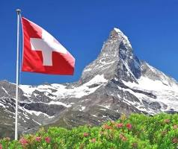
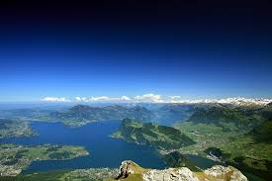
Welcome to Switzerland and Lichtenstein
Liechtenstein is a small, wealthy principality in the Alps and the smallest country in Europe, north of Switzerland:
Breathtaking Nature
High quality of life, political neutral and economic cooperation with Switzerland
Hereditary Monarchy
Closeness to Switzerland
Diplomathy in Switzerland
Dufourspitze is the highest point of Switzerland,
Lake Lucerne embedds the most historical points

Slide 2
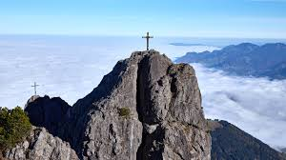
Three Sisters
Youth Hostel Schaan-Vaduz
The mountain «Three Sisters» are a mountain range of the western Central Alps. There are plenty of mountains trails to the Swiss Alps, crossing breathtaking lakes and waterfalls as well.
Historical museums are on the way to learn the Swiss history and its culture from the foundation to becoming one of the richest country in the world.
The Schaan-Vaduz Youth Hostel is the only youth hostel in Liechtenstein and is located in a quiet location on the outskirts of Schaan, close to the capital Vaduz.
It has a great view to the castle Vaduz of the monarchy and the Rhine and the Werdenbergsee in Switzerland and the Five-Castle-Tour.
www.switzerland.com
www.liechtenstein.li
schaan@youthhostel.ch

